Slide 1
Climate Change Curriculum Project
Timothy Gay – Boston Latin School
Anna Jacobs – Emmanuel College
Adnan Malek – Boston Student Advisory Coucil
Nickoliss Twohads – BSAC & Urban Science Academy

Slide 2
Climate Change and Education
In your role in BPS, how have you connected with climate change?
In what ways could you incorporate climate change into your course?
When did you first learn about climate change?

Slide 3
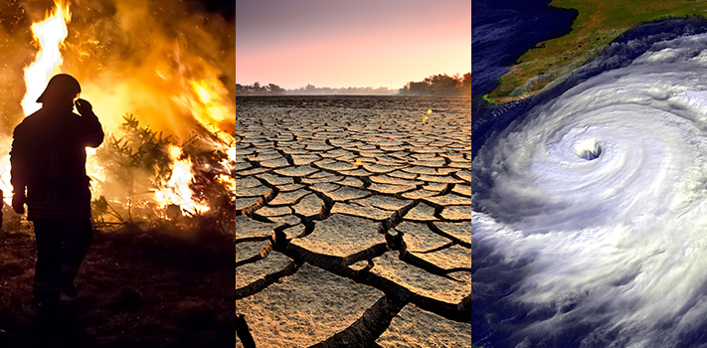
Climate Change

Slide 4
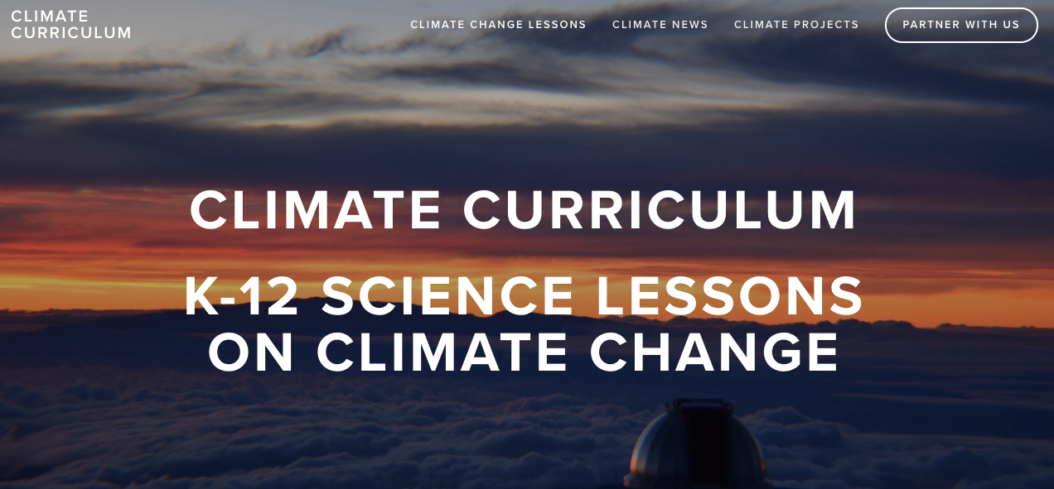
www.climatecurriculum.com

Slide 5
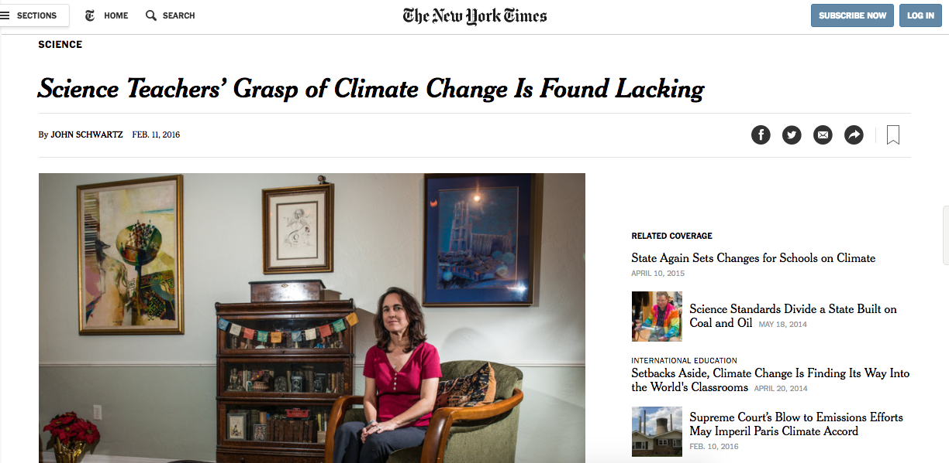
New York Times Critique

Slide 6
NYT Critique
Most science teachers in the United States spend some time on climate change in their courses, but their insufficient grasp of the science as well as political factors “may hinder effective teaching,” according to a nationwide survey of the profession.
Over 40% of teachers instruct that climate change is natural.
Only 4% of teachers were asked to teach it.

Slide 7
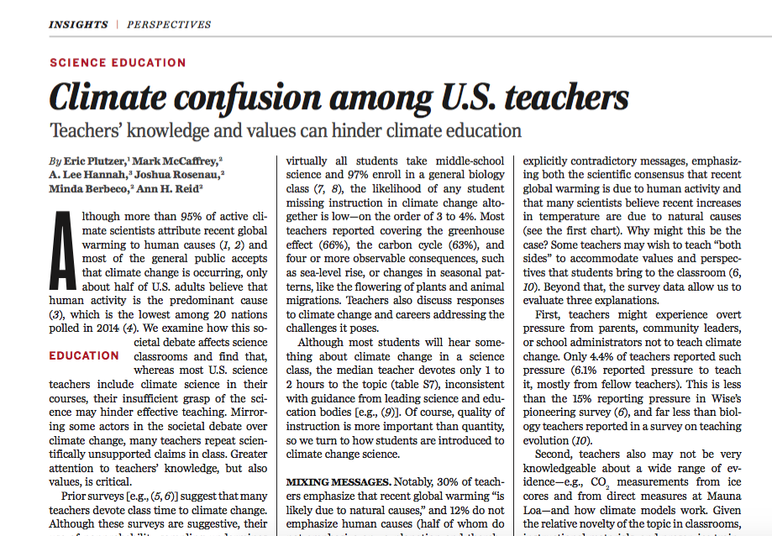

Slide 8
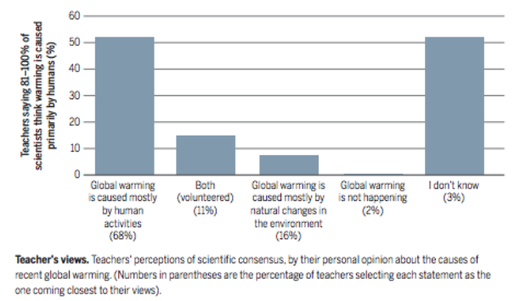
Teacher Understanding of Climate Change Scientific Consensus

Slide 9
Recommendations
“Continued development and dissemination of teacher-tested, standards aligned education materials that document the basis for the scientific consensus about human caused climate change would also be valuable. High quality, vetted, and up to date online instructional resources provide examples for teachers and science communicators.”

Slide 11
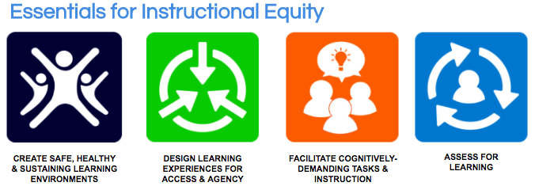

Slide 13
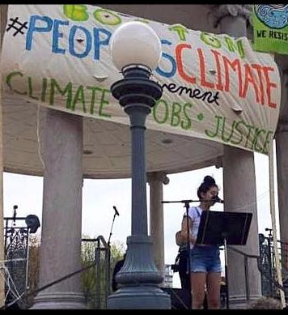
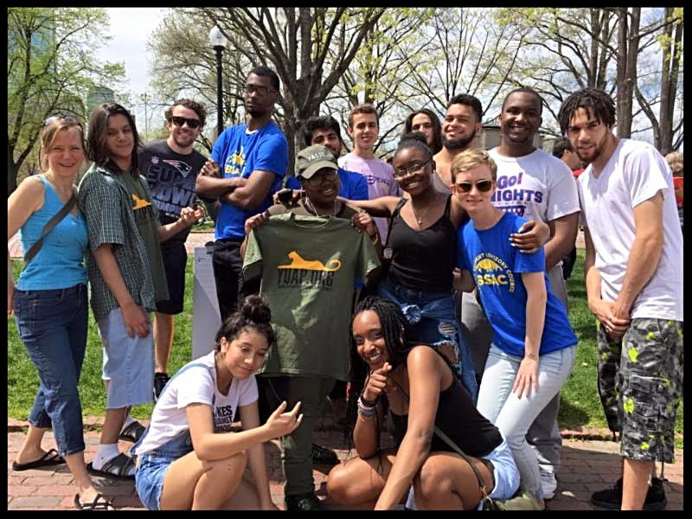
BSAC @ People’s Climate March and Climate Change Workshops

Slide 14
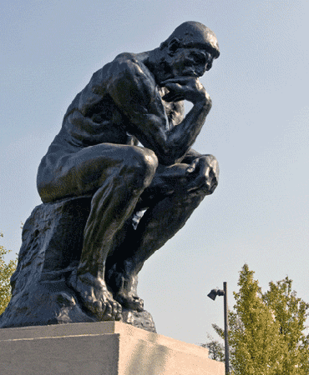
Focus Question…
How can you incorporate climate change into your role within BPS?
STEM
History/classics
English
ELL
Art/Music
Health Education

Slide 15
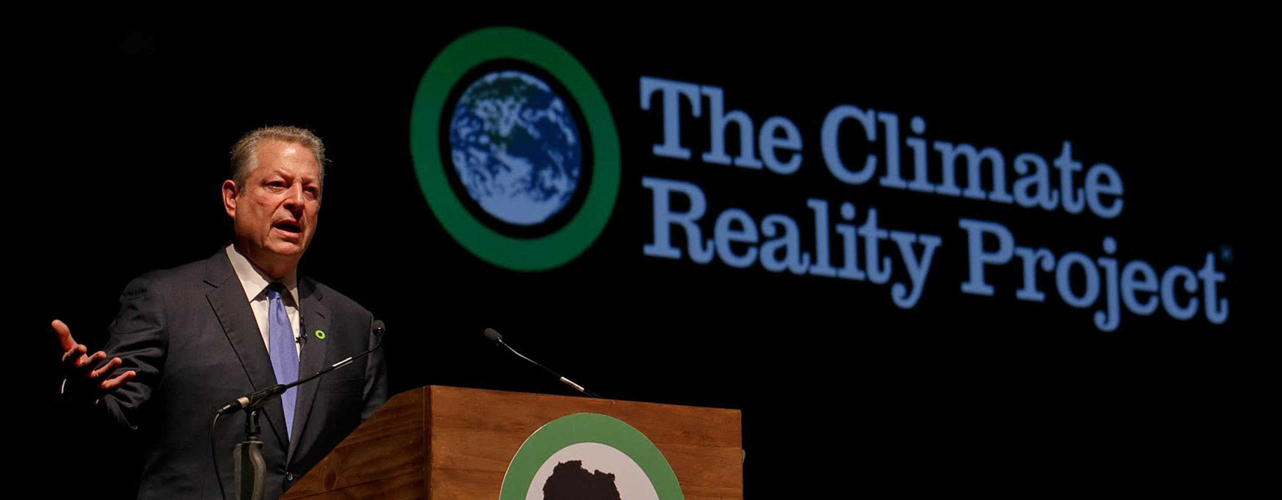

Slide 16
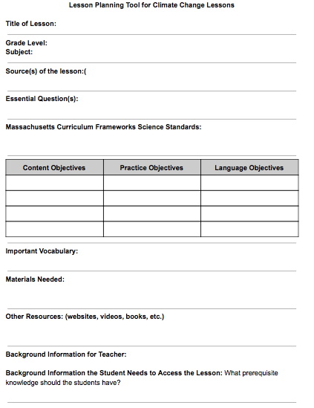

Slide 17
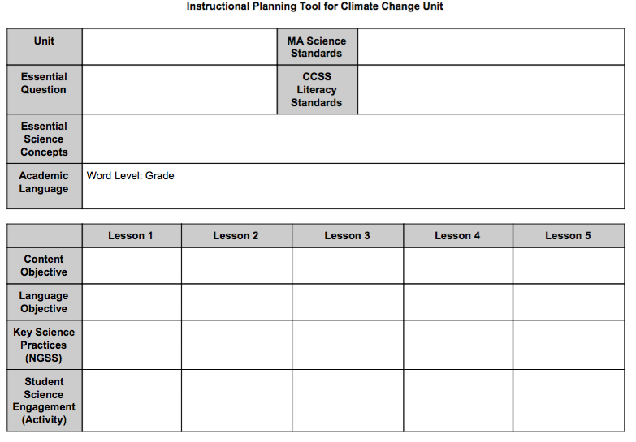

Slide 18
Climate Change Workshop
Brainstorm ideas
Speak with Climate Curriculum staff
Plan and design units and lessons for your course on climate change
Utilize curriculum and provide feedback on lessons
Mentor clubs, become an activist

